Slide 1
Manage Services and Settings in SharePoint Online Admin Center
Speaker Name

Slide 3
Objective
After completing this lesson, you will be able to:
Understand What the SharePoint Admin Center is used for?
Explain how to configure the different services available in SharePoint Online Tenant
Understand the settings that are available in SharePoint Online Admin Center
Notes:
Objectives
After completing this lesson, you will be able to:
Explain how to configure the different services available.
Understand the settings that are available in SharePoint Online.

Slide 4
Services and Settings in the SharePoint Online Admin Center

Slide 5
SharePoint Online Admin Center
The SharePoint Online Admin Center is used by SharePoint Administrators or Global Admins to administer SharePoint Online to
Set up and manage site collections in SharePoint Online
Manage storage for site collections
Configure sharing and access control policies
Configure managed metadata within the Term store
Configure and manage additional SharePoint tenant level settings
Notes:
The SharePoint Online Admin Center
It is a part of Microsoft 365 with SharePoint Online licenses subscription. You can use SharePoint Online to share ideas and expertise, build custom sites and solutions, and find information, all without the need to set up SharePoint in your datacenter. By using SharePoint Online, you can create and manage custom team-focused and project-focused sites for collaboration. You can also deploy a company-wide intranet portal to disseminate information and news across your organization. In addition, you can create a simple, public-facing website.
The SharePoint Online Admin Center Guide
The SharePoint Online Admin Center shows an administrator how to manage and maintain site collections, and enable the features that work across site collections, such as user and organizational profiles, the Term Store, and InfoPath Forms Services.
For more information about the SharePoint Online admin center, refer to https://support.office.com/en-US/article/Find-content-about-the-SharePoint-Online-admin-center-887D34FD-7C6B-4323-9E1A-4B479F2AA277

Slide 6
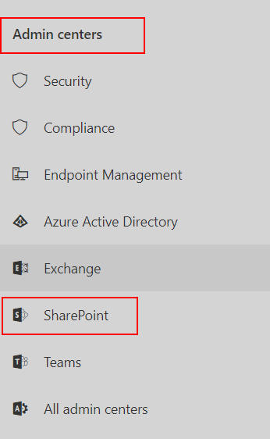
Access the SharePoint Admin Center
Go to http://admin.microsoft.com and provide your admin credentials.
Click ADMIN centers > SharePoint, at the lower-left section
Can also navigate straight to it at:
https://<tenantname>-admin.sharepoint.com
OR
https://admin.microsoft.com/sharepoint
Notes:
Access to SharePoint Admin Center
The main location where SharePoint Online is managed is called the SharePoint admin center. Microsoft 365 Midsize and Enterprise Global Administrators can access the SharePoint admin center from the Microsoft 365 admin center (https://admin.microsoft.com).
The SharePoint admin center is only for SharePoint Online Enterprise E1, SharePoint Online Enterprise E3, and SharePoint Online Enterprise E5. It is not available for Small Business subscriptions.

Slide 7
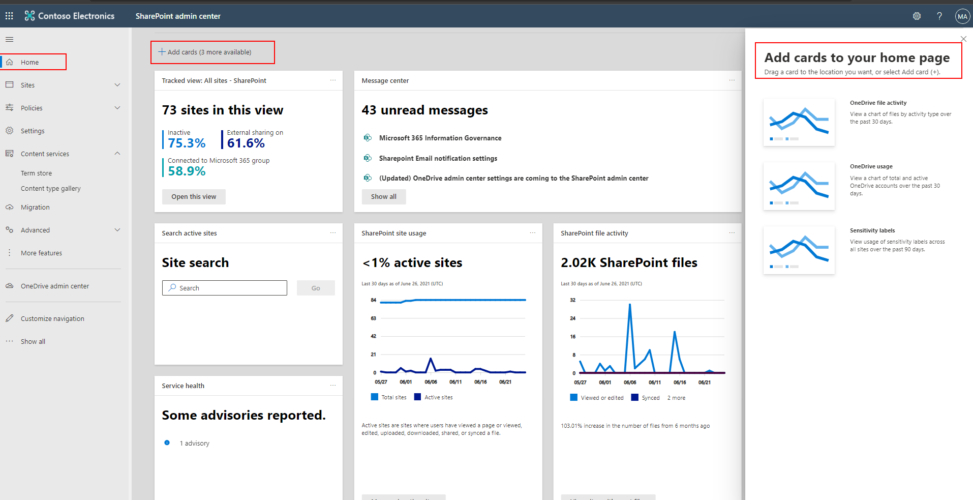
Home dashboard – Modern SharePoint Admin Center
Files by Activity type - Understand usage and growth patterns with file activity insights
Total and Active sites - quickly see information about your sites and how users are engaging with them
Message Center - Provides quick access to important notifications about SPO and ODFB
Add additional cards for more admin insights
Notes:
Home The redesigned "Home" is designed to surface the most important information and quickly help you discover some of the most important information about the service, both its health, and how your organization is using SharePoint Online.

Slide 8
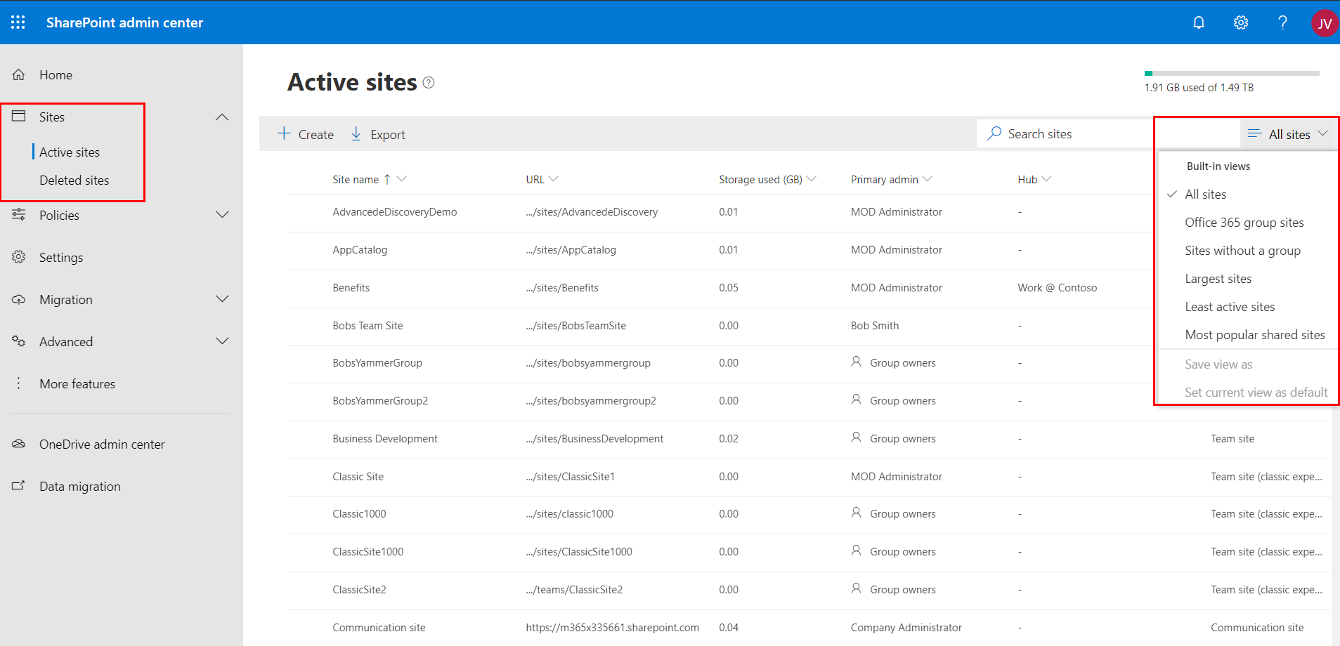
Site Management
Built in site views
Easily filter, sort, and group sites and their settings
Export list of site collections to CSV
Hub site associations
Add or remove owners
Change External Sharing setting for a site collection
Stay in the know with recent activity and more
Notes:
Home The redesigned "Home" is designed to surface the most important information and quickly help you discover some of the most important information about the service, both its health, and how your organization is using SharePoint Online.

Slide 9
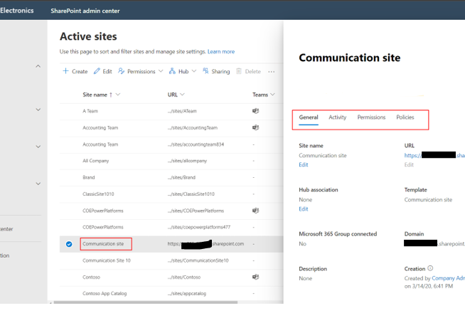
Site Collection Properties and Activity
Site Collection Insights and Properties, Activity, Permissions and Policies viewable in the modern SharePoint Admin Center
Notes:
Manage sites in the new SharePoint admin center
https://docs.microsoft.com/en-us/sharepoint/manage-sites-in-new-admin-center

Slide 10
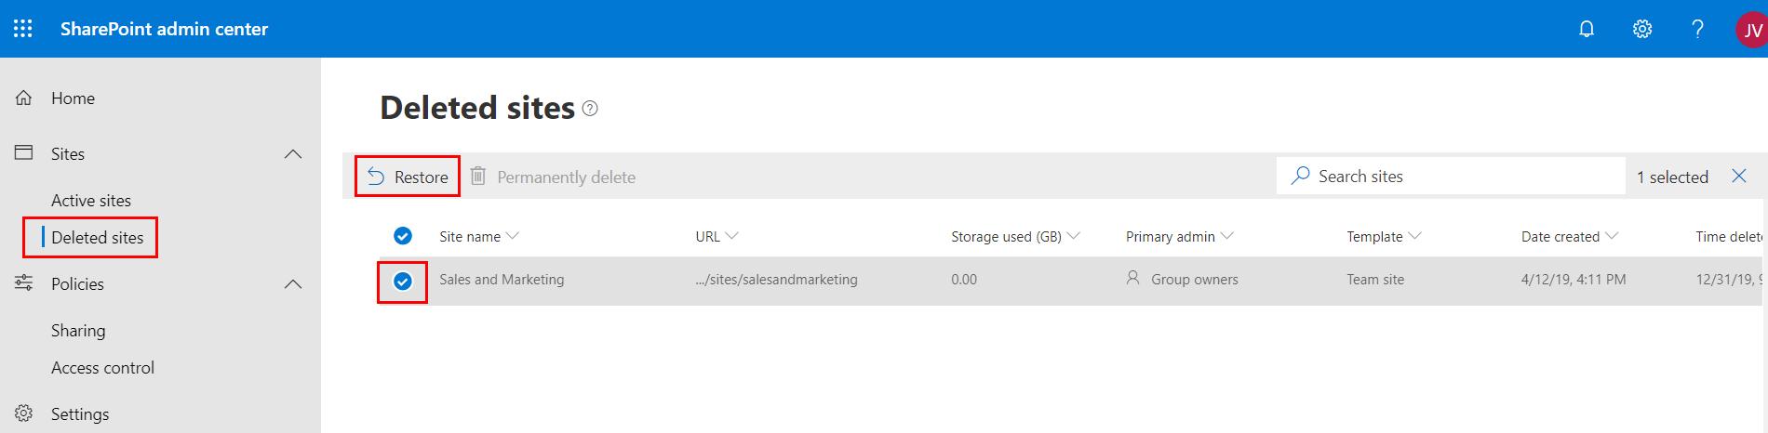
Deleted sites
Manage and recover deleted sites with ease
Deleted sites can also be permanently deleted from recycle bin
Notes:
Recycle Bin Sometimes you need information back. The Recycle bin section in the new SharePoint Admin Center provides quick access to easily manage and recover deleted sites.

Slide 11
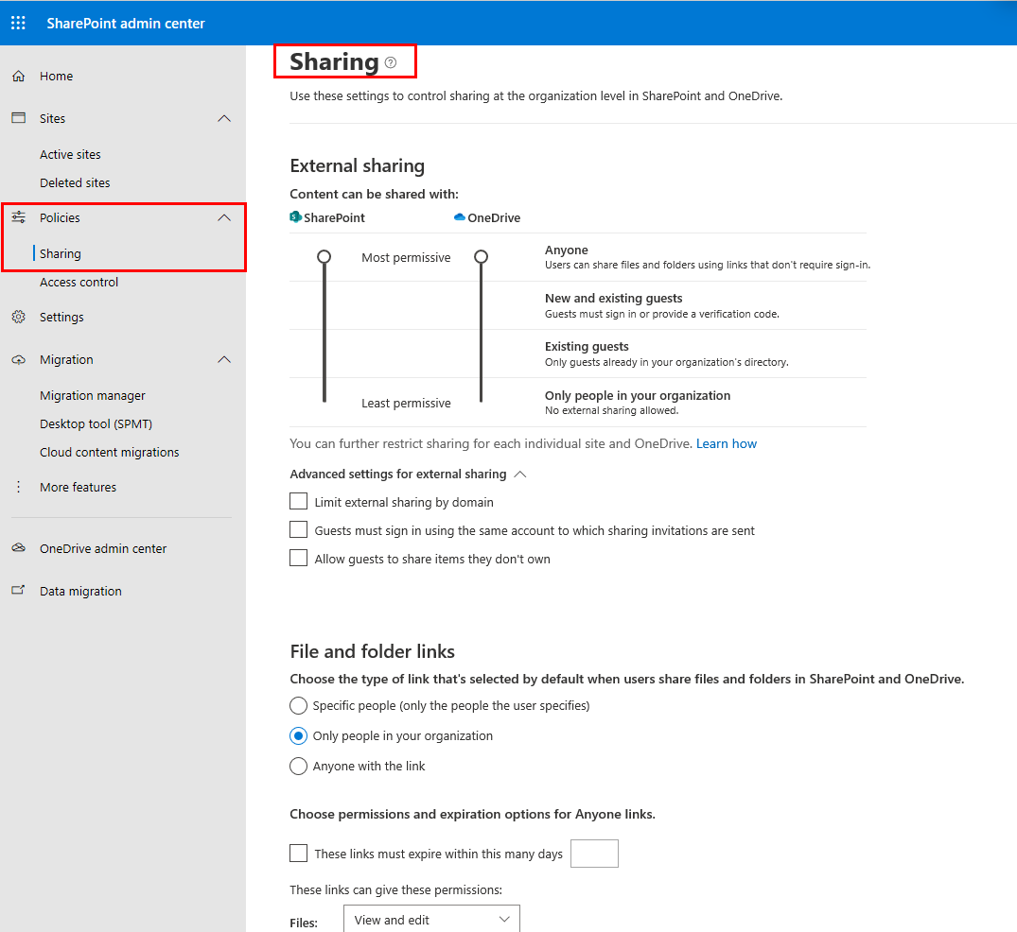
Sharing
Used to configure sharing with users outside your organization
Configure Domain white lists and block lists
Configure sharing invitation settings
Configure notifications to ODFB owners when sharing files are shared and accessed
Notes:
External Sharing is covered in detailing in Module 6 Lesson 2

Slide 12
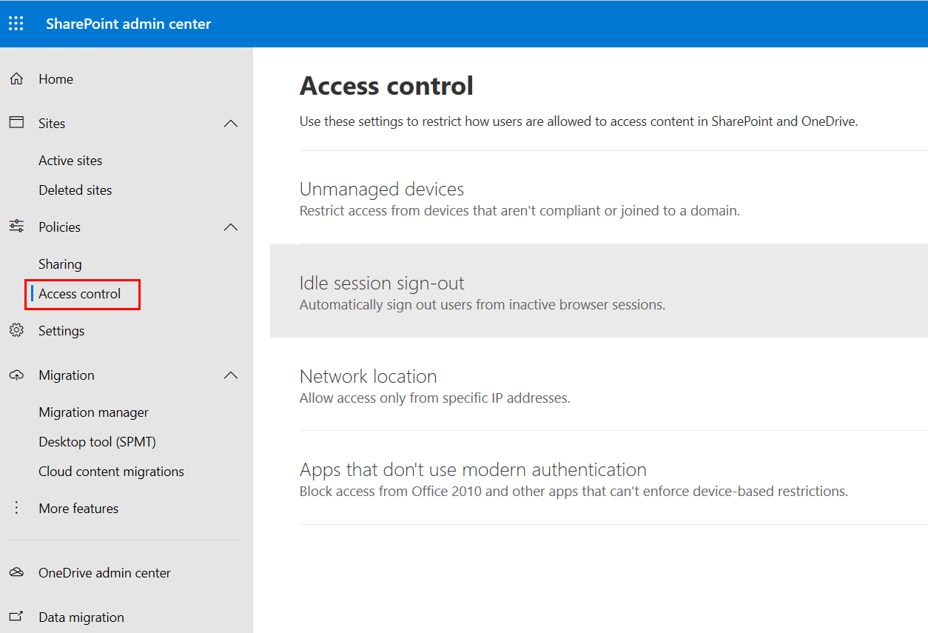
Access Control
Restrict access based on device or network location
Control access from devices that are not domain joined or compliant
Allow or block Apps that don’t use modern authentication
Control access based on network location
Notes:
Access Control is covered in detailing in Module 6 Lesson 3

Slide 13
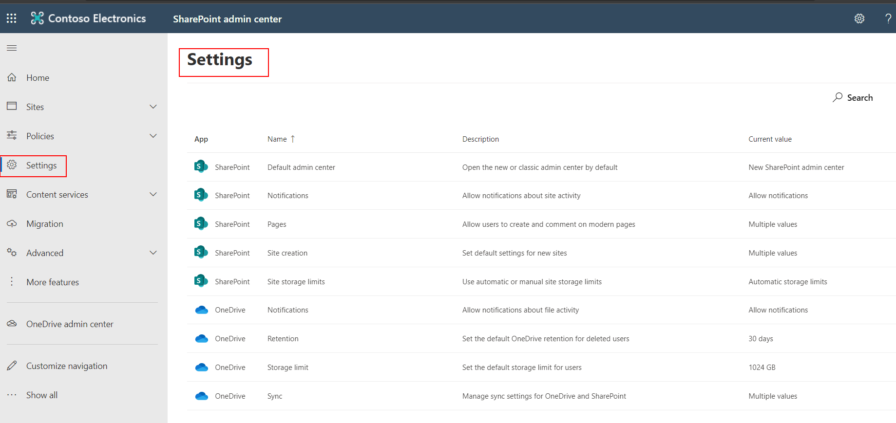
Settings
Manage settings for site storage limits, site creation, retention, sync settings and more
Notes:
Recycle Bin Sometimes you need information back. The Recycle bin section in the new SharePoint Admin Center provides quick access to easily manage and recover deleted sites.

Slide 14
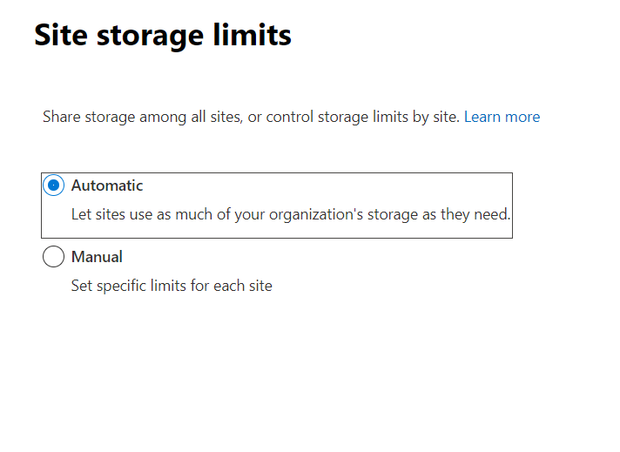
Settings: Site Collection Storage Management
Enables you to manually manage storage for your Site Collections or have the system do it Automatically
Manual lets you set a storage quota on your Site Collections (excluding OneDrive for Business)
Automatic enables you to automatically pull from your available SharePoint Online pooled storage for any and all of your site collections
Notes:
For more information, see: SharePoint Online simplifies storage management: http://blogs.office.com/2014/08/18/sharepoint-online-simplifies-storage-management/

Slide 15
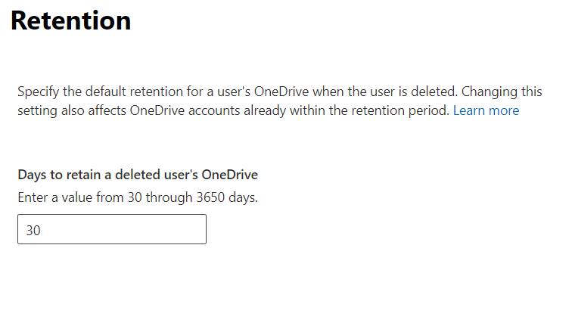
OneDrive for Business Retention
Configure the retention period for a user’s ODFB when user accounts are deleted from Azure Active Directory

Slide 16
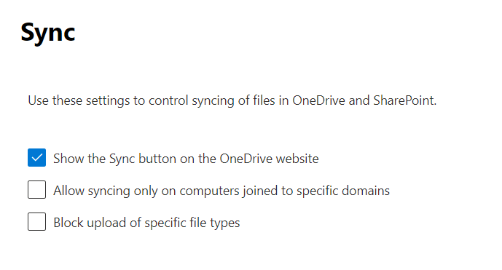
OneDrive for Business Sync
Used to control user and device access to ODFB sync

Slide 17
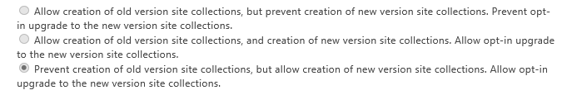
Notes: Settings: Global Experience Version Settings
Control which version of site collections can be created by end users, and whether users can upgrade them
New (non-upgraded) tenants do not have the ability to create older version (SharePoint 2010) site collections
Those options are greyed out on new tenants
Notes:
This was used when customers were migrated from the Wave14 version Microsoft 365 to the Wave15 version of Microsoft 365.

Slide 18
Content Services – Term store
Metadata: Data about data or about an information resource
By using term sets and managed terms within the Term Store, you can control which terms users can add to the content, and you can control who can add new terms
When the same terms are used consistently across sites, it is easier to build robust processes and solutions that are based on that metadata
Consistent terms and metadata make it easier to find business information and data by using Search
Notes:
Metadata is the information about information or about an information resource. Metadata can describe the resource, provide its location, or collect administrative information, such as who created the resource. For example, you might have a product catalog for clothing, and use the metadata to identify whether an item is for men, women, or children. When you use SharePoint Online, you can manage the metadata centrally. You can organize the metadata, designate who has access to it, and update it. Well-structured metadata can help make it easy to retrieve or use the information resource.
Consistent Use of Metadata: The managed metadata features in SharePoint Online enable you to control how users add metadata to the content. For example, by using term sets and managed terms, you can control which terms users can add to the content, and you can control who can add new terms. You can also limit the enterprise keywords to a specific list by configuring the Keywords term set as closed.
When the same terms are used consistently across sites, it is easy to build robust processes or solutions that rely on metadata. Additionally, it is easy for site users to apply metadata consistently to their content.
Improved Content Discoverability: When the content across sites in an organization has consistent metadata, it is easy to find business information and data by using Search. The Search features, such as the refinement panel, which displays on the left side of the search results page, enable users to filter search results based on metadata.

Slide 19
Term Store
The Term store: Used to create or manage term sets and the terms within them
A Term: A specific word or phrase that you can associate with an item on a SharePoint site
A Term Set: A group of related terms:
Local term sets are created within the context of a site collection. They are available for use (and visible) only to users of that site collection
Global term sets are defined in the Term Store. They are available for use across all sites within the tenant
Notes:
The Term Store Management Tool in SharePoint Online is the tool that people who manage taxonomies use to create or manage term sets and the terms within them. The Term Store Management Tool displays all the global term sets and any local term sets available for the site collection, from which you access the Term Store Management Tool.
A Term Set Is a Group of Related Terms
Terms sets can have different scopes, depending on where you create the term set.
Local Term Sets: Created within the context of a site collection, and are available for use (and visible) only to users of that site collection. For example, when you create a term set for a metadata column in a list or a library, then the term set is local. It is available only in the site collection that contains this list or library. For example, a media library might have a metadata column that shows the kind of media (diagram, photograph, screenshot, video, and so on). The list of permitted terms is relevant only to this library, and available for use in the library.
Global Term Sets: Available for use across all the sites that subscribe to a specific Managed Metadata Service application. For example, an organization might create a term set that lists the names of business units in the organization, such as Human Resources, Marketing, Information Technology, and more.
You can configure a term set as closed or open. In a closed term set, users cannot add new terms unless they have appropriate permissions. In an open term set, users can add new terms when they update a value for a column that is mapped to the term set.
A term is a specific word or phrase that you can associate with an item on a SharePoint site. It is a single item in a term set. A term has a unique ID and it can have many text labels (synonyms). If you work on a multilingual site, the term can have labels in different languages.
There are two types of terms:
Managed Terms: Managed terms are terms that are predefined. Term Store administrators organize managed terms into a hierarchical term set.
Enterprise Keywords: An enterprise keyword is a word or a phrase that a user adds to items on a SharePoint site. The collection of enterprise keywords is known as the Keywords set. Typically, users can add any word or phrase to an item as a keyword. This means that you can use enterprise keywords for folksonomy-style tagging. Sometimes, Term Store administrators move enterprise keywords into a specific managed term set. When they are part of a managed term set, keywords become available in the context of that term set.

Slide 20
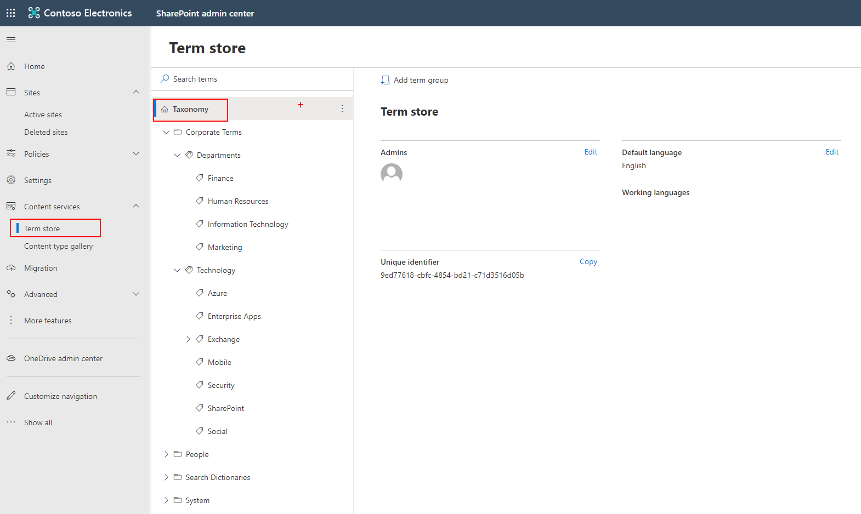
Term Store admin page
Term Group
Term Set
Terms
Notes:
Metadata is information about information. For example, a book's title and author is metadata. Metadata can be many kinds of information -- a location, a date, or a catalog item number. When you use SharePoint products, you can manage the metadata centrally. You can organize the metadata in a way that makes sense in your business and use the metadata to make it easier to find what you want.
A taxonomy is a formal classification system. A taxonomy groups the words, labels, and terms that describe something, and then arranges the groups into a hierarchy.
The Term Store management tool in the SharePoint Admin Center is used to create or manage Global term sets and the terms within the tenant. Global term sets are available for use across all sites in the Tenant. For example, an organization might create a term set that lists names of business units in the organization, such as Human Resources, Marketing, Information Technology, and so on.
The screenshot on the slide displays the layers (Groups, Term Sets, and Terms) within a tenant term store. Term Set
A Term set is a group of related terms.
Terms sets can have different scope, depending on where you create the term set.
Local term sets are created within the context of a site collection, and are available for use (and visible) only to users of that site collection. For example, when you create a term set for a metadata column in a list or library, then the term set is local. It is available only in the site collection that contains this list or library. For example, a media library might have a metadata column that shows the kind of media (diagram, photograph, screen shot, video, etc.). The list of permitted terms is relevant only to this library, and available for use in the library.
Global term sets are available for use across all sites that subscribe to a specific Managed Metadata Service application. For example, an organization might create a term set that lists names of business units in the organization, such as Human Resources, Marketing, Information Technology, and so on.
In addition, you can configure a term set as closed or open. In a closed term set, users can't add new terms unless they have appropriate permissions. In an open term set, users can add new terms in a column that is mapped to the term set.
Terms
A term is a specific word or phrase that you associated with an item on a SharePoint site. It is a single item in a term set. A term has a unique ID and it can have many text labels (synonyms). If you work on a multilingual site, the term can have labels in different languages.
There are two types of terms:
Managed terms Managed terms are terms that are pre-defined. Term Store administrators organize managed terms into a hierarchical term set.
Enterprise keywords An enterprise keyword is a word or phrase that a user adds to items on a SharePoint site. The collection of enterprise keywords is known as the Keywords set. Typically, users can add any word or phrase to an item as a keyword. This means that you can use enterprise keywords for folksonomy-style tagging. Sometimes, Term Store administrators move enterprise keywords into a specific managed term set. When they are part of a managed term set, keywords become available in the context of that term set.
To learn more about how to create and manage terms, see Create and manage terms in a term set.
Group
In SharePoint products, group is a security term. With respect to managed metadata, a group is a set of term sets that all share common security requirements. Only users who have contributor permissions for a specific group can manage term sets that belong to the group or create new term sets within it. Organizations should create groups for term sets that will have unique access or security needs.

Slide 21
Demonstration
Modern SharePoint Admin Center
Notes:
Click the Try it now and navigate into the home dashboard and site management. Example Demo Steps
Go to SharePoint Admin Center
Talk about the dashboard and Analytics about sites
Click through the left nevigation and highlight different options.
Talk about Active and Deleted sites and what funcationality is available as of today
Click on Create under active sites to show different available options for new sites
Show filters on the left side of Active Sites to demonstrate the ability to quickly filter information
Show more if time permits

Slide 22
More Features and Services in SharePoint Online
Apps (Add-ins)
BCS
User Profiles
Secure store
Managed metadata and the Term Store
Search
Records Management
Access controls

Slide 23
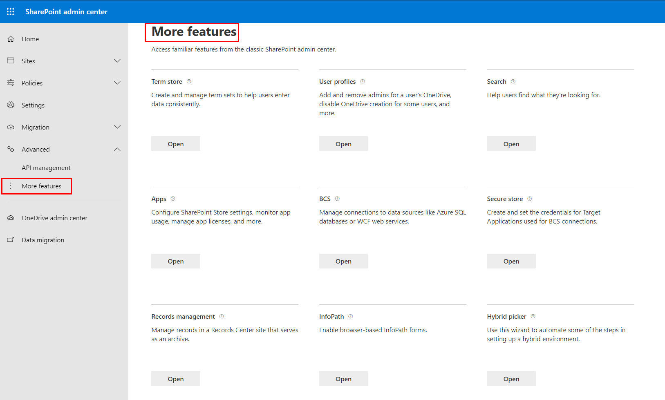
More Features Administration page

Slide 24
User Profiles
A collection of user properties—and the policies and settings associated with each of those properties—that describe a single user
User profiles help people:
Find subject matter experts
Learn more about each other
Collaborate by using the social features
Information from a user’s profile properties are surfaced in Delve
Notes:
A user profile is the collection of user properties—and the policies and settings associated with each of those properties—that describe a single user. User profiles are important, because they help people to find subject matter experts, learn more about each other, and collaborate using social features, such as microblogging and recommendations.
The default user profile properties are fed into SharePoint Online from the Microsoft 365 directory service. However, a SharePoint Online administrator can enhance the SharePoint capabilities by adding user profile properties, defining user policies, and creating audiences. Features, such as Newsfeed, Sites, and People Search rely on user profiles to provide a rich, personalized experience for the people in your organization.
You may decide to add profile properties, such as current projects and hobbies, and then set up the property policy to allow people to fill in information about themselves, usually through their About Me page.
For more information about SharePoint Online admin, see: http://office.microsoft.com/en-us/office365-sharepoint-online-enterprise-help/redir/HA102816050.aspx?CTT=5&origin=HA102772733
For more information about adding user profile properties, see: https://support.office.com/en-us/article/Add-and-edit-user-profile-properties-85091402-737f-4bb9-99a7-bc5f194502a8?ui=en-US&rs=en-US&ad=US
For more information about defining user policies, see: http://office.microsoft.com/en-us/office365-sharepoint-online-enterprise-help/redir/HA103518164.aspx?CTT=5&origin=HA102772733
For more information about creating audiences, see: http://office.microsoft.com/en-us/office365-sharepoint-online-enterprise-help/redir/HA102772738.aspx?CTT=5&origin=HA102772733
For more information about Newsfeed, see: http://office.microsoft.com/en-us/office365-sharepoint-online-enterprise-help/redir/HA102772278.aspx?CTT=5&origin=HA102772733
For more information about sites, see: http://office.microsoft.com/en-us/office365-sharepoint-online-enterprise-help/redir/HA102772278.aspx?CTT=5&origin=HA102772733
For more information about People Search, see: http://office.microsoft.com/en-us/office365-sharepoint-online-enterprise-help/redir/HA103994122.aspx?CTT=5&origin=HA102772733
For more information about how people can fill in information about themselves, see: http://office.microsoft.com/en-us/office365-sharepoint-online-enterprise-help/redir/HA102785967.aspx?CTT=5&origin=HA102772733

Slide 25
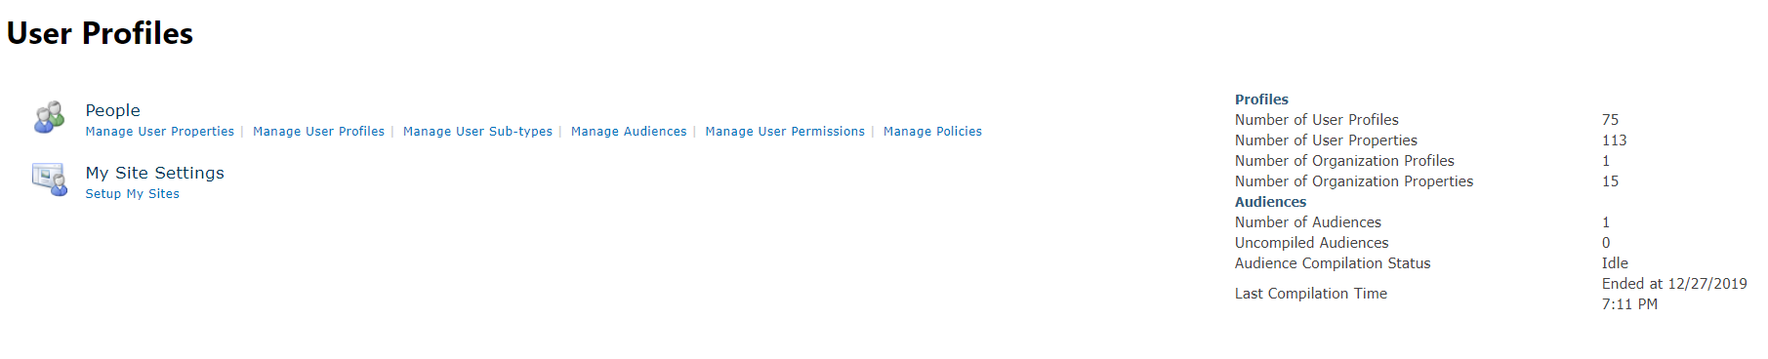
User Profiles admin page
Notes:
About Microsoft 365 and SharePoint Profile Synchronization
SharePoint Online receives profile information from the Microsoft 365 directory service during the regularly scheduled one-way synchronization, which should occur at least every 24 hours.
When your organization signs up and deploys Microsoft 365, the user accounts will either be:
Manually created and added to the Microsoft 365 directory service.
Or
Synced with an on-premises Active Directory Domain Services (AD DS).
If your organization manually created user accounts in the Microsoft 365 directory service, then users will receive Microsoft Azure Active Directory (Azure AD) credentials for signing into Microsoft 365. These credentials are separate from other desktop or corporate credentials. You will use Microsoft 365 admin center to make changes to these user accounts.
Your organization may choose to use the Microsoft 365 Directory Synchronization (DirSync) tool to populate user information from an on-premises AD DS. DirSync supports federated single sign-on.
For more information about the Microsoft 365 directory service, see Active Directory Synchronization in Microsoft 365 (http://office.microsoft.com/en-us/office365-sharepoint-online-enterprise-help/redir/XT103524705.aspx?CTT=5&origin=HA102772733).
The Directory Synchronization tool (DirSync) allows on-premises AD DS user profiles to be synchronized with the Microsoft 365 directory service, which is then synced with SharePoint Online user profiles. AD DS information only goes in one direction—from the on-premises Active Directory server to SharePoint Online. This ensures that user information in SharePoint Online reflects the most current and accurate state of your user data in AD DS.
Note: Automatic profile synchronization with the Microsoft 365 directory service occurs at regular predetermined intervals. Changes may take up to 24 hours before they appear in a user’s profile.
About SharePoint Profile Properties and Policies
By default, SharePoint Online user profiles are populated by the Microsoft 365 directory service. Basic profile properties, such as a user’s first and last name, phone number, and job title, are also synchronized. If there are additional properties that you would like to add to user profiles to enhance search and collaboration features within SharePoint, then the SharePoint Online admin can create those user profile properties.
Note: When you create a new user profile property by using SharePoint Online admin center, it will not create that property in the Microsoft 365 directory—this user profile data will be unique to SharePoint Online.
As shown in the illustration on the slide, a user’s About Me page can be composed of properties that are imported from the Microsoft 365 directory service and from custom SharePoint Online profile properties. For example, the directory service will supply default user profile information, such as the users’ account names, work telephone numbers, job titles, and work email addresses. Users will not be allowed to edit this information. However, if you use the SharePoint admin center to add user profile properties, such as current projects or personal interests, you should make sure that you define the property policy to allow users to edit those properties from their About Me page.
For more information about creating user profile properties, see: http://office.microsoft.com/en-us/office365-sharepoint-online-enterprise-help/redir/HA102772741.aspx?CTT=5&origin=HA102772733
For more information about property policy, see: http://office.microsoft.com/en-us/office365-sharepoint-online-enterprise-help/redir/HA103518164.aspx?CTT=5&origin=HA102772733

Slide 26
Demonstration
Configure My Site Settings
Notes:
To Configure My Site Cleanup Secondary Owner
Verify that the user account that is performing this procedure is a SPO Admin or Global Admin account.
On the SharePoint Online Administration Center Home page, click User Profiles.
On the Manage User Profiles page, in the My Site Settings section, click Setup My Sites.
Scroll down to My Site Cleanup and enter an account (ie Admin@tenant.onmicrosoft.com) in the Secondary admin box and resolve the account
Inform students that this is used when a user's profile has been deleted that user's My Site will be flagged for deletion after thirty days. To prevent data loss, access to the former user's My Site can be granted to the user's manager or, in the absence of a manager, a secondary My Site owner. This gives the manager or the secondary owner an opportunity to retrieve content from the My Site before it is deleted. Select whether or not ownership of the Site should be transferred to a manager or secondary owner before the site is deleted.
Set a secondary owner to receive access in situations in which a user's manager cannot be determined.
5. Scroll down to My Site Secondary Admin and enable My Site secondary admin setting and enter an account to be the secondary admin (ie admin@tenant.onmicrosoft.com) Inform students they can add a secondary admin for all My Sites (AKA ODFB sites).
You can add a user or security group as a second admin to users' My Sites. Typically, the user who the site is being created for is the only site admin. When you enable a secondary admin, the user or security group selected will always be a site admin on all new My Sites.

Slide 27
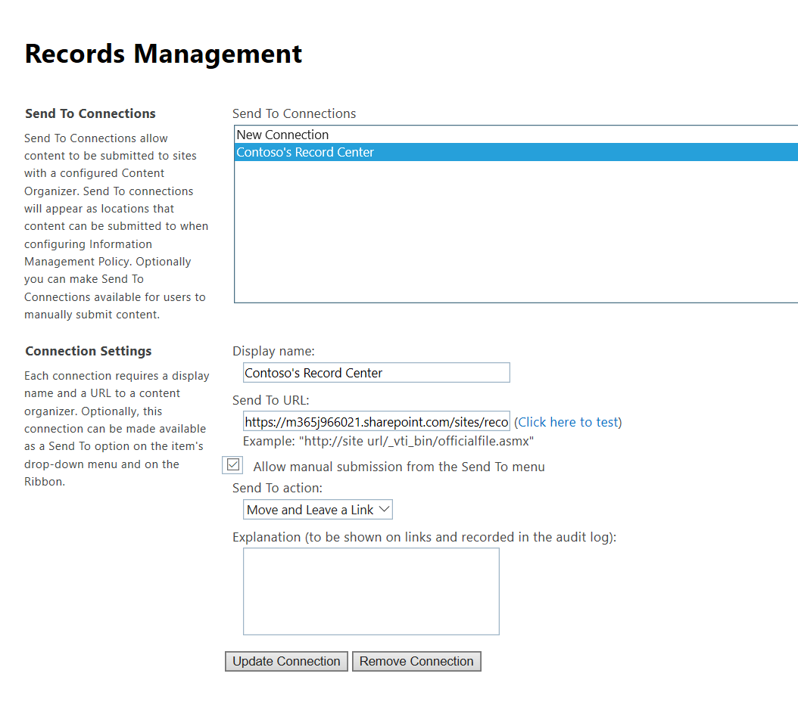
Records Management admin page
Notes:
Content Organizer: The records router can use metadata to route incoming documents to the right place in the hierarchical file plan. For instance, it enables you to automatically enforce rules on content that is submitted, such as If a Purchase Agreement is tagged with Project Alpha, send to the Alpha Contracts subfolder and apply its folder retention policy to the item.
Virtual Folders: The file plan is a great way to manage a repository, but often is not what you would like to use to navigate and find the content that you are looking for. The SharePoint 2010 Records Center makes use of a new feature called metadata based navigation, which allows you to expose key metadata as virtual folders.

Slide 28
Classic Search admin page
Notes:
As a SharePoint Online administrator, you can customize the search experience for the users. This customization includes:
Defining searchable managed properties in the search schema.
Identifying high-quality pages to improve relevance.
Managing query rules and result sources.
Removing individual results.
You can also evaluate any changes by viewing reports about usage and search.
The changes you make from the search administration page are valid for the whole tenant. However, you can also customize search on site collection level and on site level.
Manage the search schema: Create a customized search experience by changing the search schema. In the search schema, you can view, create, or change managed properties, and map crawled properties to managed properties.
For more information, see: http://office.microsoft.com/client/15/help/preview?AssetId=HA103628856&lcid=1033&NS=SPOAdmin&Version=15&CTT=5&origin=HA103728204
Manage search dictionaries: Use search dictionaries to include or exclude company names to be extracted from the content of your indexed documents, or you can include or exclude words for query spelling correction.
For more information, see: http://office.microsoft.com/client/15/help/preview?AssetId=HA103629159&lcid=1033&NS=SPOAdmin&Version=15&CTT=5&origin=HA103728204
Manage authoritative pages: Influence the pages or documents that should appear at the top of your list of search results by identifying high-quality pages, also known as authoritative pages.
For more information, see: http://office.microsoft.com/client/15/help/preview?AssetId=HA103629113&lcid=1033&NS=SPOAdmin&Version=15&CTT=5&origin=HA103728204
Manage query suggestion settings: Add phrases that you want the system to suggest to the users, as they search for an item. Also, add phrases that you do not want the system to suggest to the users.
For more information, see: http://office.microsoft.com/client/15/help/preview?AssetId=HA103639759&lcid=1033&NS=SPOAdmin&Version=15&CTT=5&origin=HA103728204
Manage result sources: Result sources limit searches to certain content or to a subset of search results. You can create your own result sources, or change the predefined result sources.
For more information, see: http://office.microsoft.com/client/15/help/preview?AssetId=HA103639370&lcid=1033&NS=SPOAdmin&Version=15&CTT=5&origin=HA103728204
Manage query rules: Improve search results by creating and managing query rules. Query rules can help searches respond to the intent of the users.
For more information, see: http://office.microsoft.com/client/15/help/preview?AssetId=HA103673857&lcid=1033&NS=SPOAdmin&Version=15&CTT=5&origin=HA103728204
Manage query client types: Query client types decide the order in which queries are performed.
For more information, see: http://office.microsoft.com/client/15/help/preview?AssetId=HA103639818&lcid=1033&NS=SPOAdmin&Version=15&CTT=5&origin=HA103728204
Remove search results: Temporarily remove items from the search results with immediate effect. These items can be documents, pages, or sites that you do not want the users to see when they search.
For more information, see: http://office.microsoft.com/client/15/help/preview?AssetId=HA103630752&lcid=1033&NS=SPOAdmin&Version=15&CTT=5&origin=HA103728204
View usage and search reports: View usage reports and search reports and see how often your users search, what their top queries are, and which queries they are having trouble getting answers for.
For more information, see: http://office.microsoft.com/client/15/help/preview?AssetId=HA103640042&lcid=1033&NS=SPOAdmin&Version=15&CTT=5&origin=HA103728204
Manage Search Center settings: Choose where the searches should go by specifying the URL of your Search Center.
For more information, see: http://office.microsoft.com/client/15/help/preview?AssetId=HA103673941&lcid=1033&NS=SPOAdmin&Version=15&CTT=5&origin=HA103728204
Import and export customized search configuration settings: Export and import customized search configuration settings between tenants, site collections, and sites.
For more information, see: http://office.microsoft.com/client/15/help/preview?AssetId=HA103640067&lcid=1033&NS=SPOAdmin&Version=15&CTT=5&origin=HA103728204
Manage crawl log permissions: Grant users or groups the read access to the crawl log information for the tenant. A typical use case is in eDiscovery, where the users may need to check whether the crawled content was in fact added to the search index.
For more information, see: http://office.microsoft.com/client/15/help/preview?AssetId=HA103675567&lcid=1033&NS=SPOAdmin&Version=15&CTT=5&origin=HA103728204
Another benefit of the Secure Store Service is that it eliminates authentication prompts for the users. When users navigate to SharePoint Online pages that access external data systems, the Secure Store Service is active in the background, checking the user rights, and providing mapped credentials to the external data when appropriate. This allows the users to access the required data without prompting them to enter user names and passwords specific to the external application.

Slide 29

Apps (Add-ins)
SharePoint Online admin can create an App Catalog site to make internally developed custom apps available to users:
Purchase apps
Manage licenses for apps
Monitor apps
Manage app access to a tenant
Notes:
As a SharePoint Online administrator, you can create an App Catalog site to make internally developed custom apps available for the users to install when they browse apps under the From Your Organization filter on the Site Contents page. Site owners can then add these apps to customize sites with specific functionality or to display information.
After an App Catalog site has been created, you can use it to upload any custom apps that your organization has developed. Uploading custom apps is not much more complicated than uploading a document to a library and setting some properties. You can also use the App Catalog site to do things, such as install custom or third-party apps on sites for users (also called app deployment). You can also manage app requests from users.

Slide 30
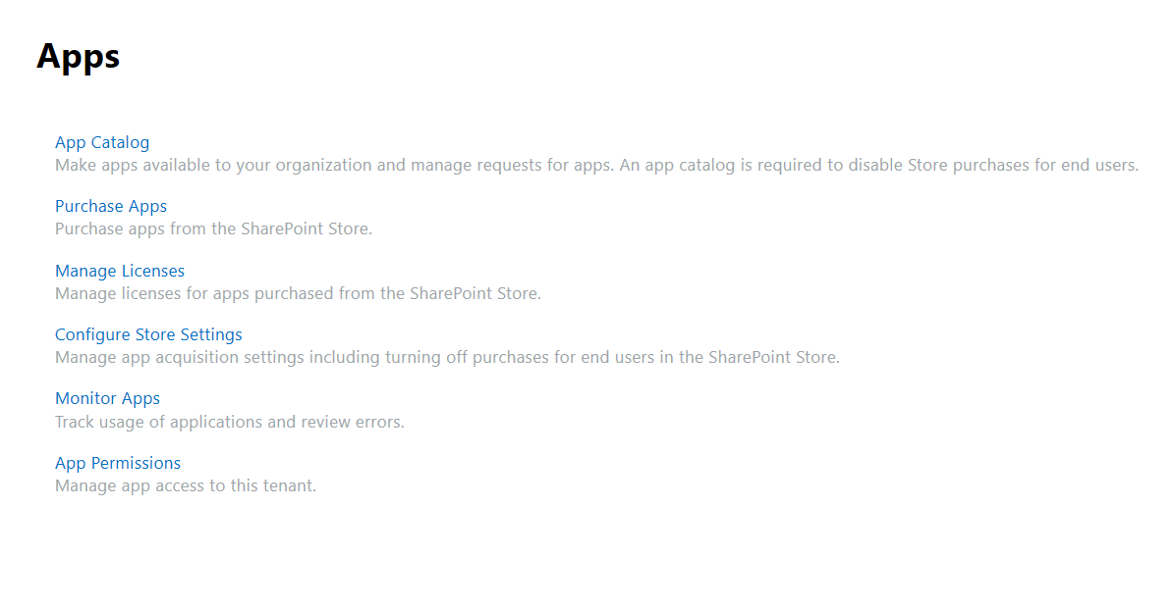
SharePoint Admin Center: Apps

Slide 31
Knowledge Check
If you would like to set a Site Collection storage quota, what Site Collection Storage Management setting will you choose?
What is the difference between Local Term Sets and Global Term Sets?
Where do you configure Sharing Invitation settings for SharePoint Sites and OneDrive Sites?
Manual allows you to set SC storage quotas.
Local Term Sets are defined within a site collection and the terms are available only within that site collection. Global Term Sets are defined in the Term Store at tenant level and are available to all sites within the SharePoint Online tenant.
Sharing options in SharePoint Admin Center.

Slide 32
Summary
In this lesson, you learned about:
Tenant-level SharePoint service applications, and what they are used for.
The other tenant-level settings for SharePoint Online, like external sharing, ODFB Sync client settings, term store management.

Slide 33
Lab
SharePoint Admin Tenant Administration

